Slide 1

CLUSTERING
UCI Wholesale Customers Dataset
MASTER OF SCIENCE OF INFORMATION SYSTEMS
INTELLIGENT SYSTEMS
K-means vs DBSCAN
STUDENTS (GROUP2) | AINEDEMBE DENIS 2024-M132-23999
 | MUSINGUZI BENSON 2024-M132-23947
LECTURER | Dr. Sibitenda Harriet

Slide 2
Objective
A comprehensive clustering analysis comparing K-means and DBSCAN algorithms on the UCI Wholesale Customers Dataset.
This activity performs customer segmentation to identify distinct purchasing patterns and provide actionable business insights.

Slide 3
Dataset
The dataset is about clients of a wholesale distributor. It includes the annual spending in monetary units (m.u.) on different product categories:
Fresh, Milk,
Grocery, Frozen,
Detergents_Paper,
Delicassen;
And then
Channel/Region information.

Slide 4
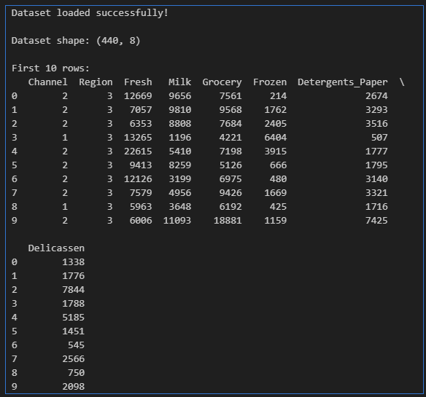
Loaded the dataset

Slide 5
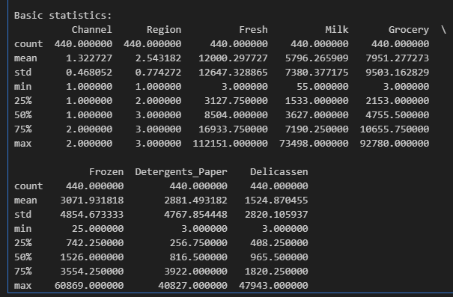
Showing basic Statistics

Slide 6
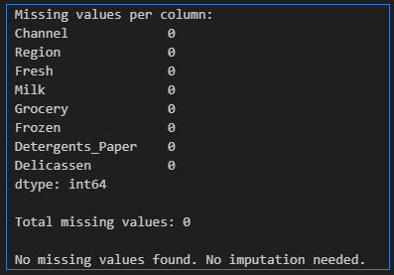
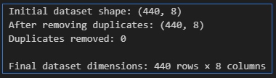
Handle missing data & Removing Duplicates
Handle missing data
Removing exact duplicates

Slide 7
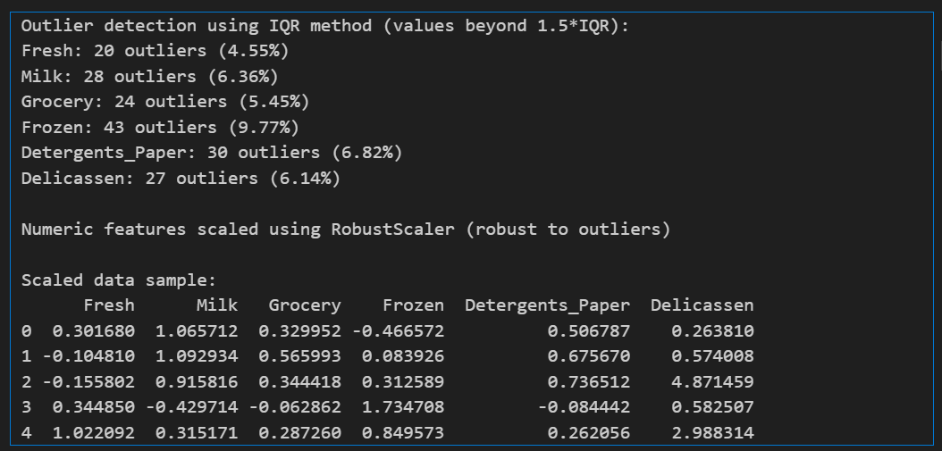
Outlier detection using IQR method

Slide 8
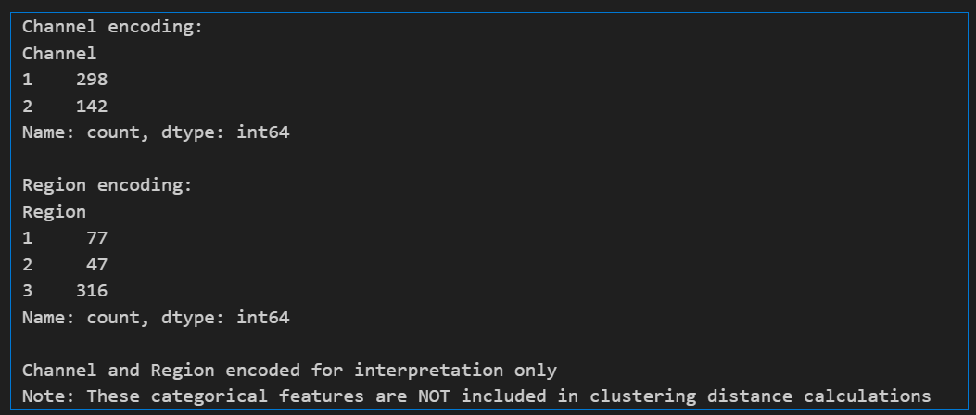
Encode Channel and Region for interpretation

Slide 9
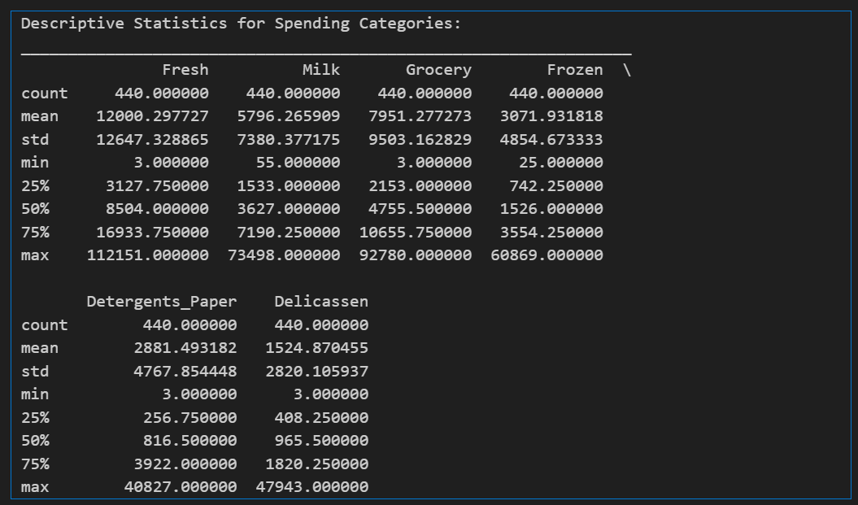
Descriptive statistics for spending categories

Slide 10
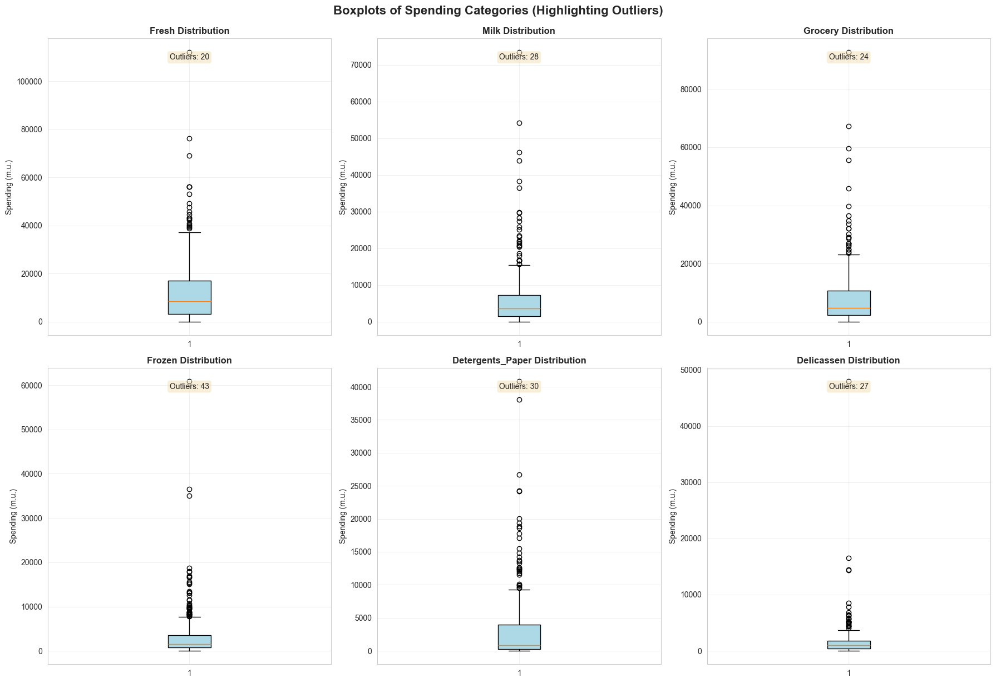
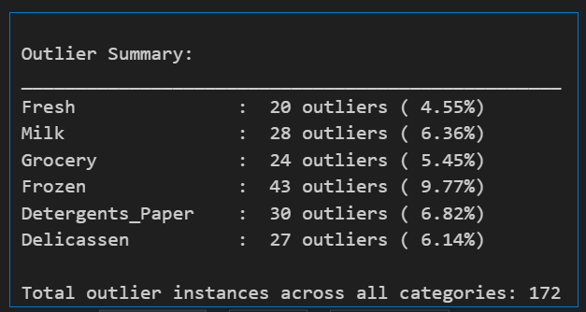
Spending categories. Outliers and giving counts

Slide 11
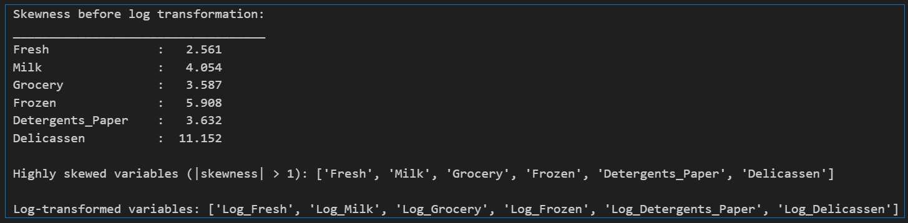
Log-transform highly skewed spending variables
Identify highly skewed variables (|skewness| > 1)
Log transform highly skewed variables

Slide 12
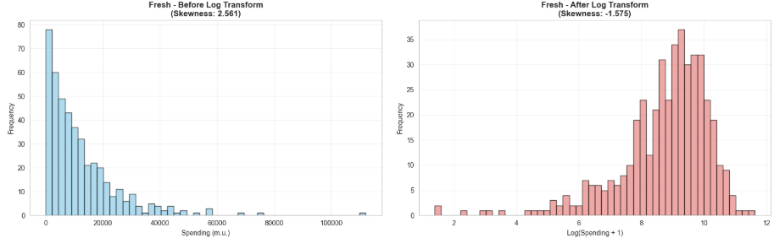
Before/ after histograms for log-transformed variables

Slide 13
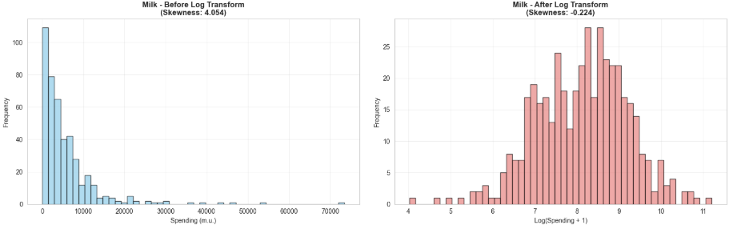
Before/ after histograms for log-transformed variables

Slide 14
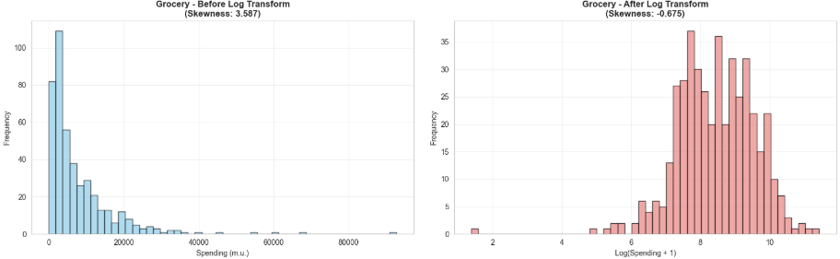
Before/ after histograms for log-transformed variables

Slide 15
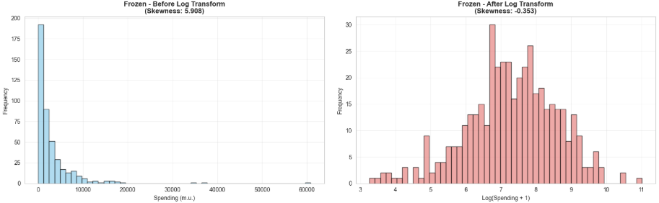
Before/ after histograms for log-transformed variables

Slide 16
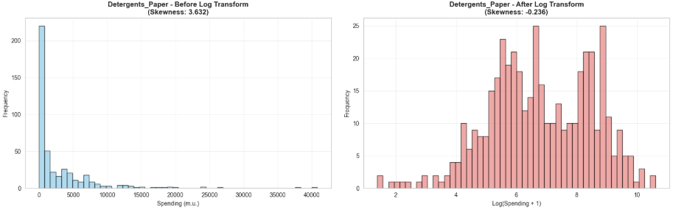
Before/ after histograms for log-transformed variables

Slide 17
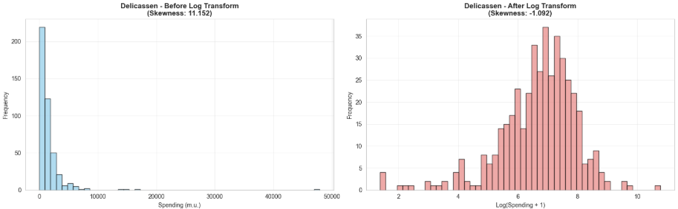
Before/ after histograms for log-transformed variables

Slide 18
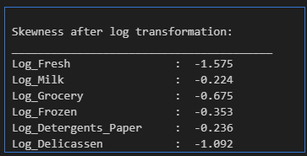
Before/ after histograms for log-transformed variables

Slide 19
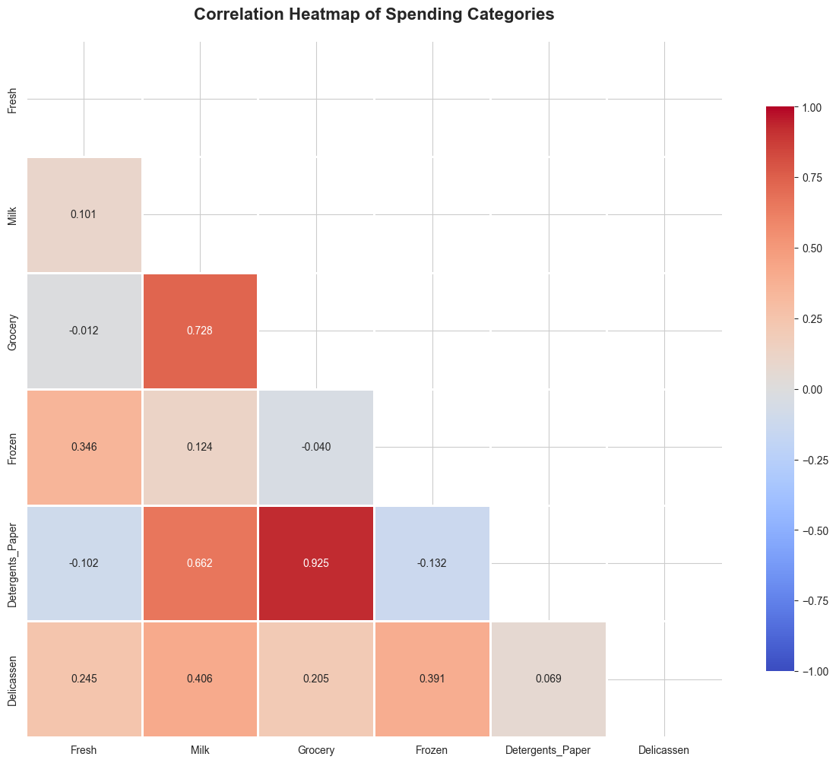
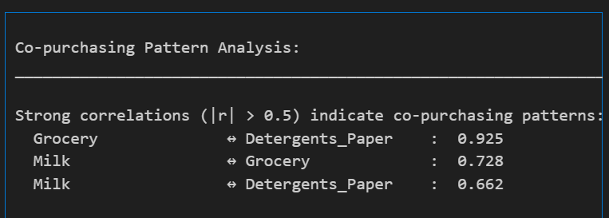
Correlation heatmap of spending categories
Insights:
• High correlation suggests customers who buy one category also buy the other
• This can inform cross-selling strategies and inventory management

Slide 20
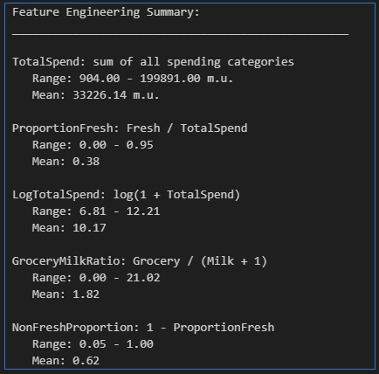
Feature Engineering & Aggregation

Slide 21
Feature Engineering & Aggregation
Justification for Derived Features:
TotalSpend: Captures overall customer value and spending capacity. Essential for segmenting high-value vs low-value customers.
ProportionFresh: Reveals customer preference for fresh vs processed products. Helps identify customer segments with different product preferences.
LogTotalSpend: Normalizes the highly skewed total spending distribution, making it more suitable for clustering algorithms that assume normal distributions.
GroceryMilkRatio: Identifies customers who prefer grocery items over milk products, useful for product mix optimization.
NonFreshProportion: Complements ProportionFresh by focusing on processed/frozen products, important for supply chain planning

Slide 22
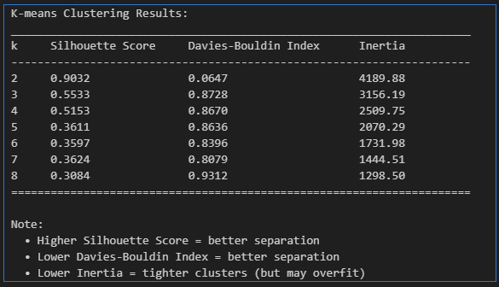
K-means Clustering

Slide 23
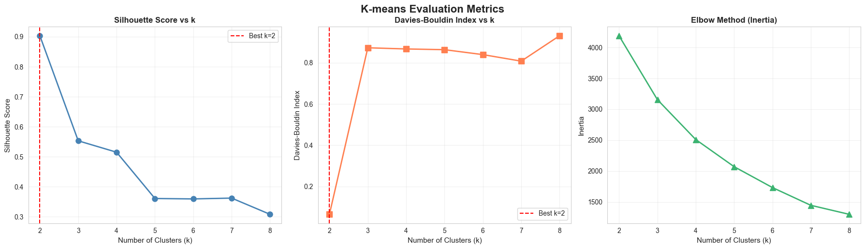
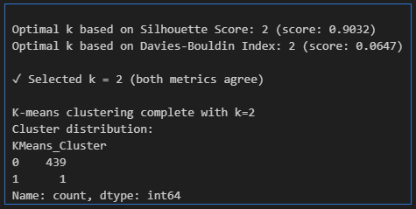
K-means evaluation metrics

Slide 24
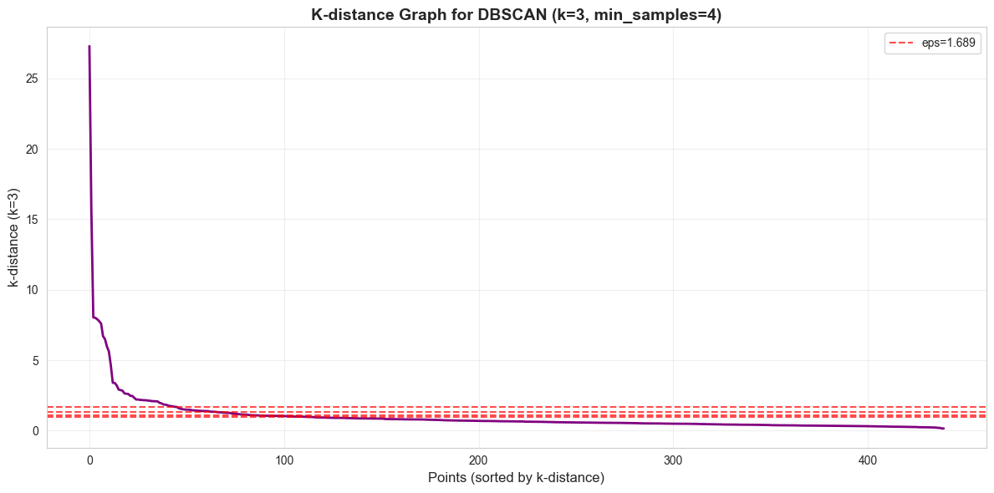
DBSCAN Clustering: k-distance plot to choose eps

Slide 25
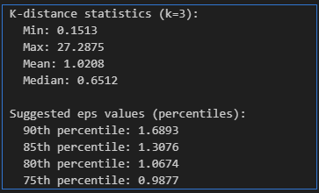
DBSCAN Clustering: k-distance plot to choose eps

Slide 26
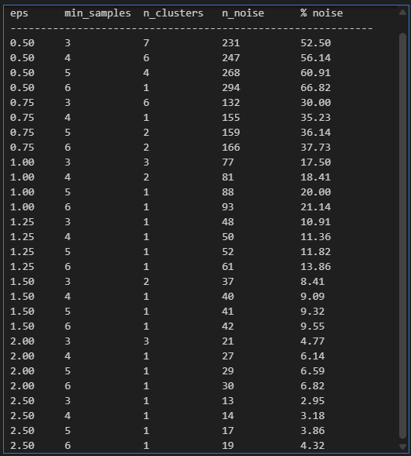
DBSCAN Results for Different Parameters

Slide 27
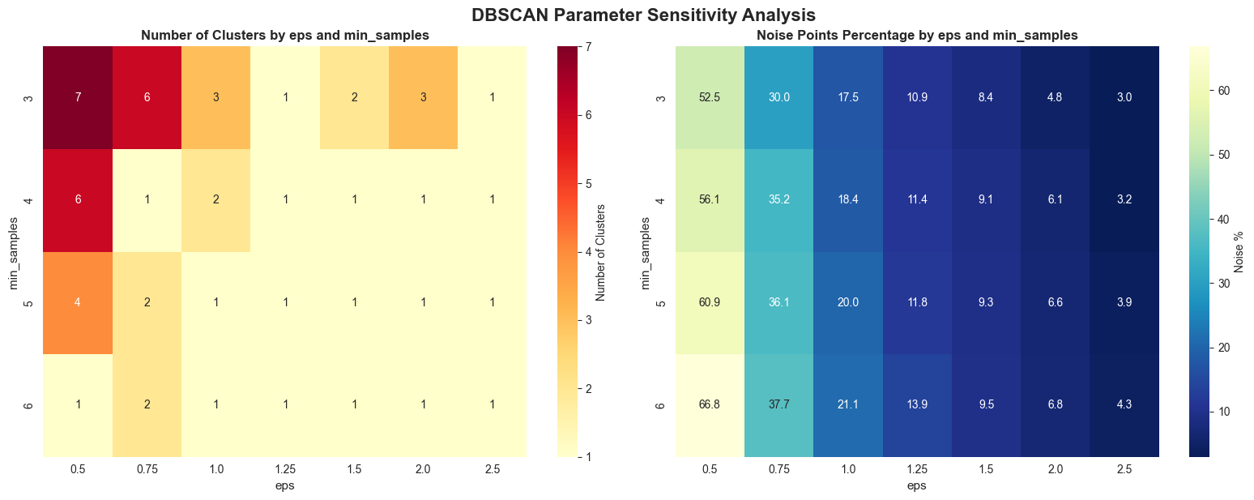
DBSCAN parameter sensitivity

Slide 28
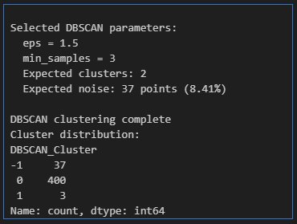
DBSCAN parameter sensitivity

Slide 29
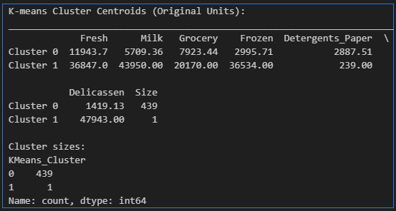
Second EDA & Statistical Inference
K-means Cluster Centroids (Original Units)

Slide 30
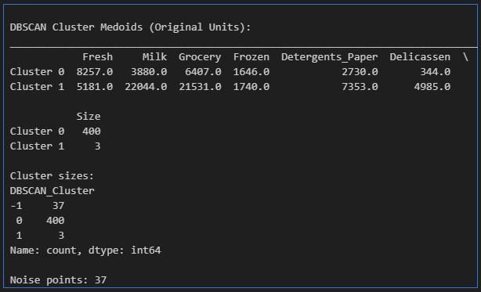
Second EDA & Statistical Inference
DBSCAN Cluster Medoids (Original Units)

Slide 31
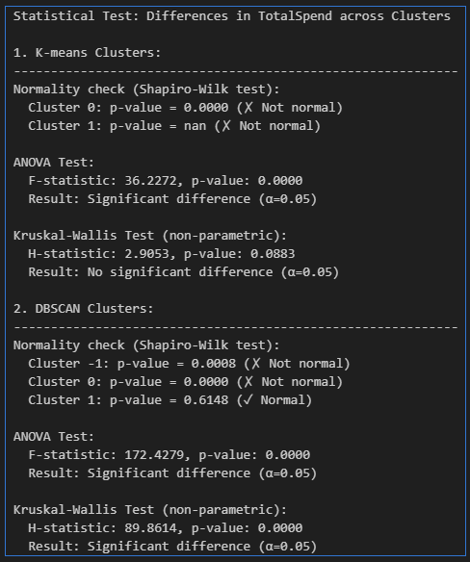
Differences in TotalSpend across Clusters

Slide 32
THE END
STUDENTS | AINEDEMBE DENIS +256 788-674576 dembedenisjb@gmail.com, ainedembe.denis@stud.umu.ac.ug
 | MUSINGUZI BENSON +256 782 942245, musiben@gmail.com, musinguzi.benson@stud.umu.ac.ug
LECTURER | Dr. Sibitenda Harriet +256 777 056581 hsibitenda@umu.ac.ug

